Slide 1
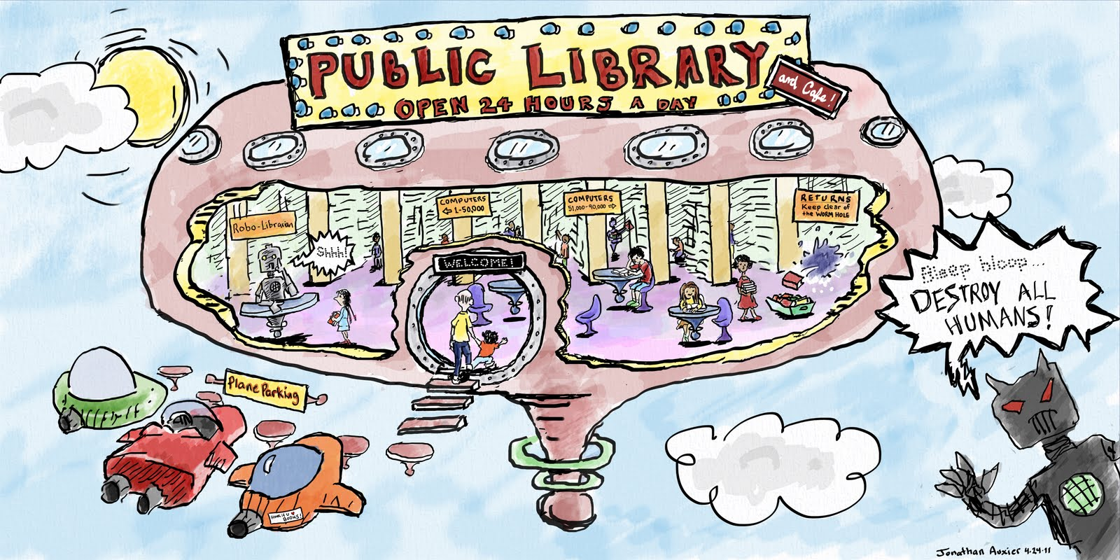
Future state – rethinking ‘Library’

Slide 2

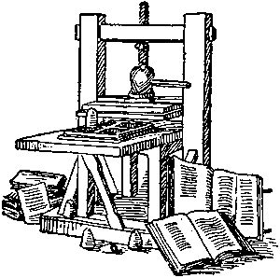
Paradigm shift
Notes:
Public Libraries have been modifying and changing since they first morphed from mechanics Institutes in the 1850’s. Change in public libraries is not new. What is new is the rapidity of that change currently and the paradigm shift caused by the World Wide Web, the biggest systemic change to impact on the dissemination of knowledge and ideas since the invention of the printing press.

Slide 3
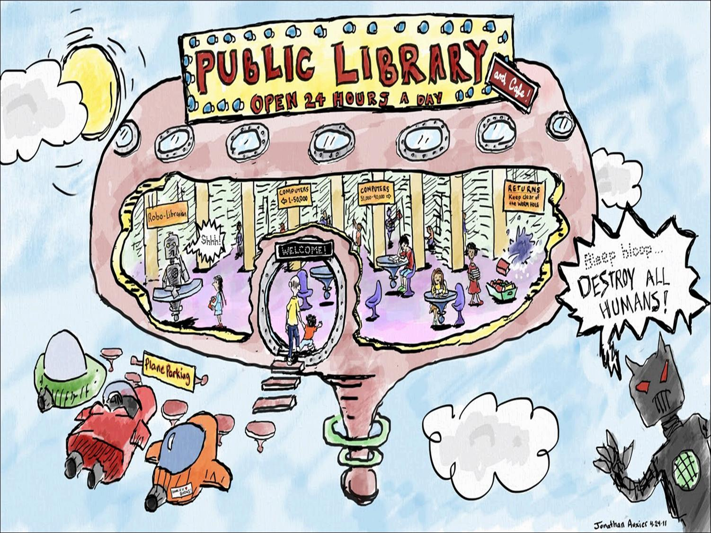
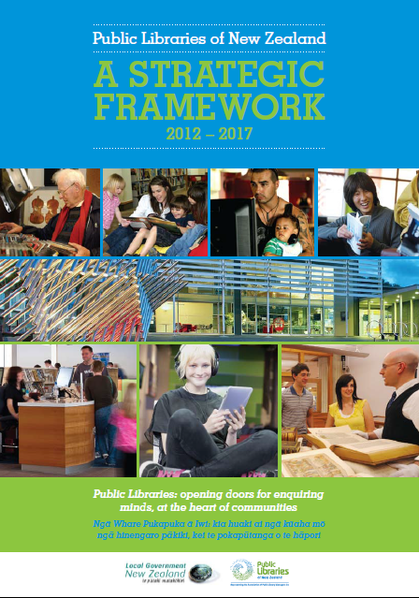
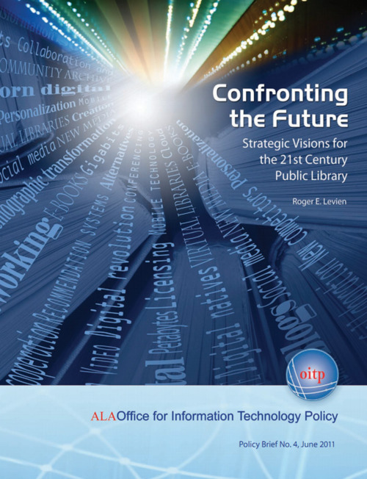
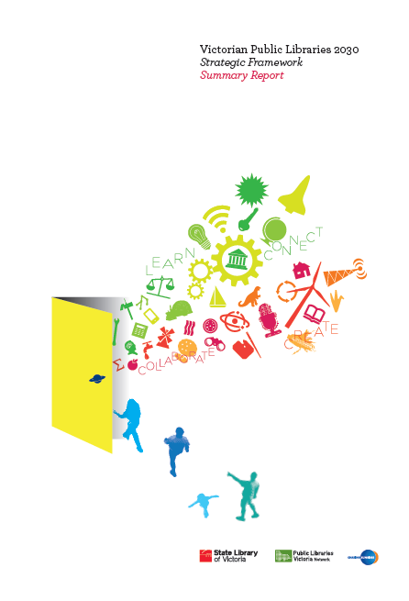
Notes:
The future of public libraries is being hotly debated. New Zealand, the USA, Australia and many others have produced strategic frameworks, policies and discussion documents which demonstrate and discuss how libraries are changing and will change to respond to a different future.
Although there are differences from country to country in shaping the future some common themes are apparent: the library is a place of connection and community, a creative place, where the digital and physical worlds come together. Libraries are in the business of creative leisure and life long learning and are seen as being at the heart of community democracy providing equal opportunity for all.
The future of libraries is a topic in the media with many from outside the sector joining the debate both supportive of their future and not. Those who think it may not have a future as an important public institution largely see the library as being a place for books and information, rather than a place for people with leisure and learning needs.

Slide 4



Liberal whingers are wrong – we should shut our libraries - 17 January 2014
The future of libraries – keeping the service alive -25 November 2013
The Future of Libraries in a Digital Culture – 11 October 2012
Notes:
The future of libraries is a topic in the media with many from outside the sector joining the debate both supportive of their future and not. Those who think it may not have a future as an important public institution largely see the library as being a place for books rather than a place for people seeking ideas, knowledge and inspiration. And that place is now both physical and digital.

Slide 5
Leisure
Learning
Library
Creative
Reading
Writing
Music
Watching video/film
Games
Experiencing
Programmes
Social media
Conversation
Relax/Hangout
Reading
Researching
Information seeking
Experimenting
Making video/film
Programmes
Writing
Social media
Discussion/debate
Informal
Organised sport
Games
Playground
Swimming
Cycling
Climbing
Gardening
Pre school
School
University
Polytechnic
Online courses
Exams
Accreditation
Formal
Active
Leisure
Learning
Notes:
In thinking about where QLDC libraries go in the future it is helpful to think about what is the business that libraries are in? Public libraries are in the leisure and learning business – creative leisure and learning for life to be more specific. Other enterprises also operate in the leisure and learning space so what is it that libraries contribute and what value are they adding? This model classifies leisure into active and creative – your district has a host of opportunities for active recreation both in the natural environment and in things such as the event centre, playgrounds, parks and sports fields. Creative recreation covers a range of activities such as reading, writing and listening and can be an individual or a collective pursuit. Learning can be formal or informal. Formal learning is usually associated with an educational institution and results in some form of accreditation or qualification. Informal learning happens throughout life and may be as significant as researching and writing a family history, or just finding out how to tackle a new skill. In childhood there is no real distinction between creative leisure and learning – children learn by doing, they learn through play. As we age we often see these activities as more distinct. However, if someone is learning a new skill such as quilting, by reading about it and watching a DVD, they are also participating in creative leisure.

Slide 6
Economic benefit of libraries
For every $1.00 spent there is a ROI of between $3.00 to $5.00
Notes:
As to the value that libraries contribute most people would recognise the social benefit in terms of better informed citizens, greater literacy and reading ability, community cohesion and participation but not many would think about the economic benefits that accrue from libraries. Numerous studies in the USA, Australia and Canada, done by economists and accounting professionals using recognised cost benefit and other techniques have found that libraries return between $3.00 and $5.00 for every $1.00 spent.

Slide 7
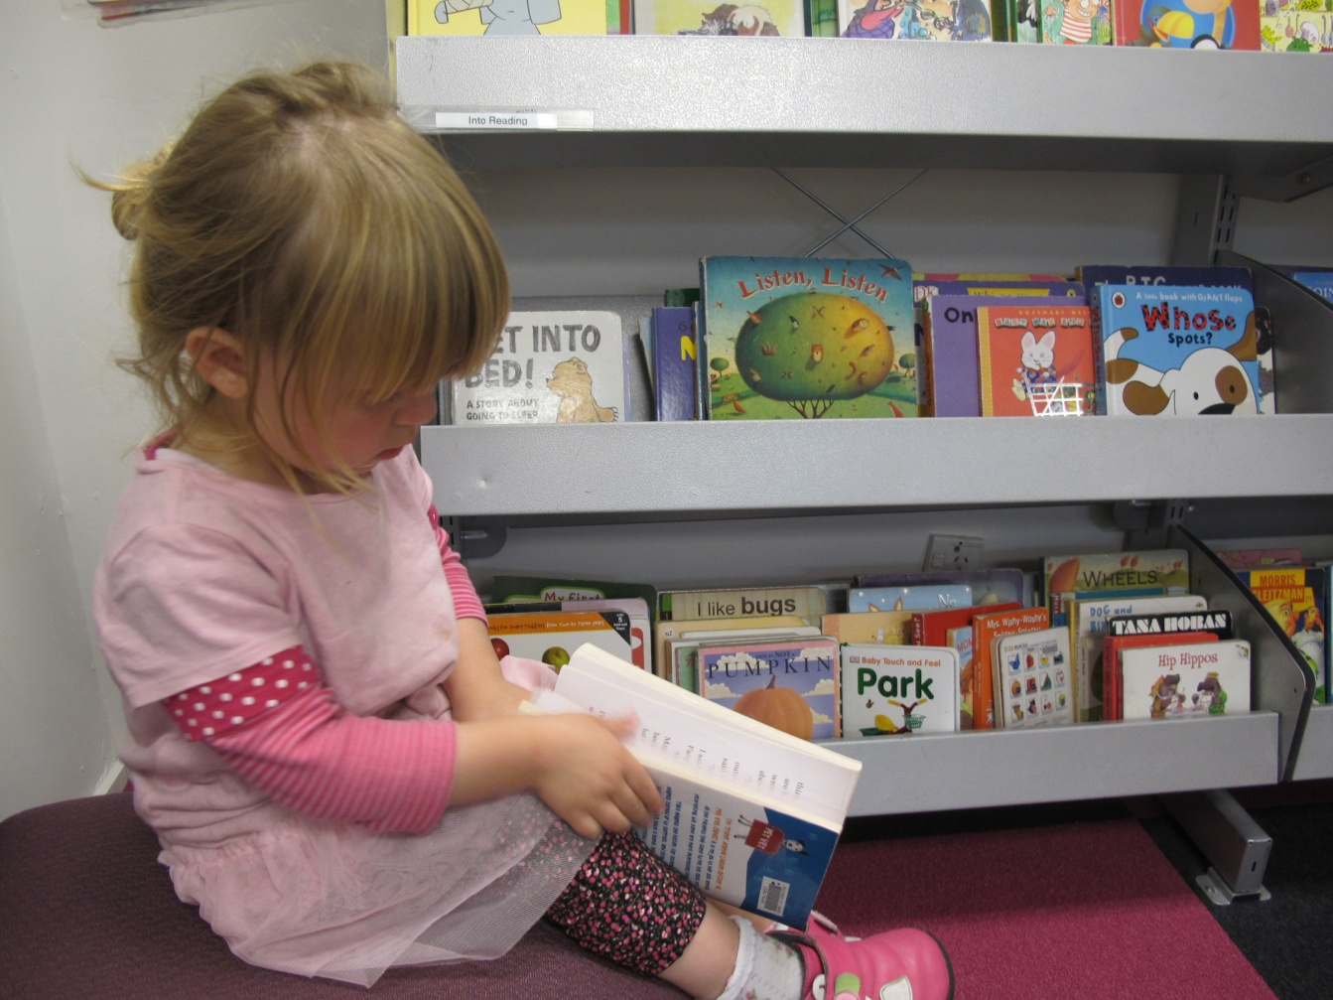
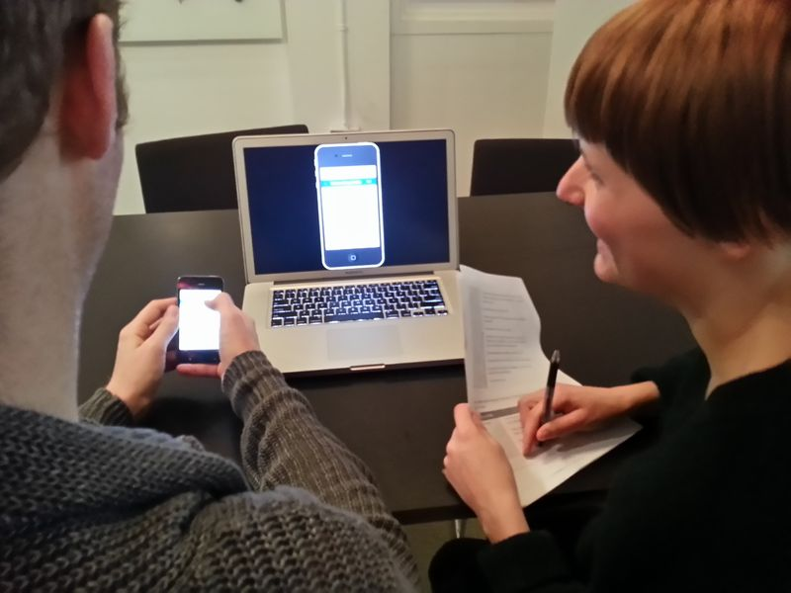
Reading literacy
Digital literacy
Notes:
Returning to learning and leisure - For a person to make the most of their opportunities for learning and leisure they need the foundational skills of reading. Like any skill the more you practice reading the better you become at it. Libraries and literacy are intertwined and it is why much of a library’s programming in the past has been in the area of reader development. But the skill of reading is no longer sufficient to access the world of knowledge – a person needs a range of digital and media literacies and libraries are now providing support to customers with getting the best from the devices and applications that enable learning and creativity to happen in different ways.

Slide 8
Future state – so what is happening in libraries?

Slide 9
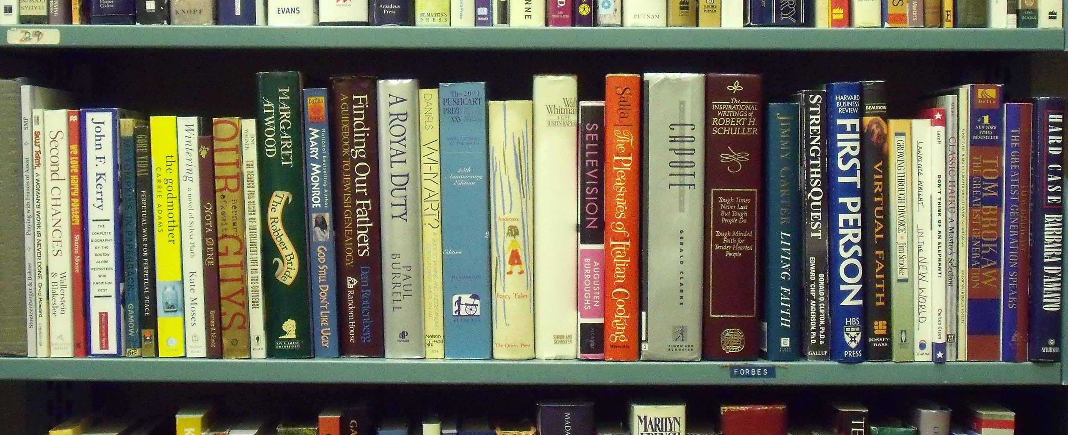
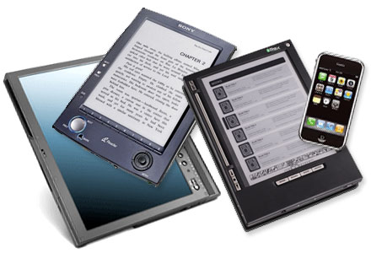
Notes:
Libraries, including QLDC have moved into lending eBooks. Currently the range and number is small but the Australian Library and Information Association predicts that eBook collections will form half of the library’s collection by 2020. This remains to be seen. What we do know though is that the uptake of eReading is increasing alongside the reading of physical materials. It is our view that over the next ten years it will not be an either/or but a both/and situation with an increasing demand for eBooks. Demand is there but the business models with the publishers and aggregators are still being sorted. Ereaders and mobile devices are making “A Library in every pocket” a reality.

Slide 10

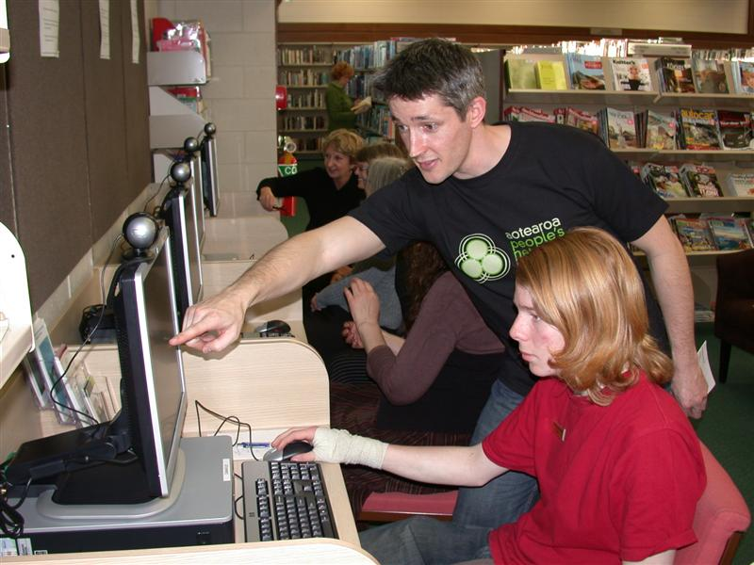

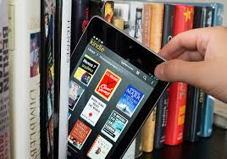
80% of libraries in NZ provide free access to the internet and wifi – 90% of these through the APNK
The remainder charge or partially charge
Trend is towards mobile devices – both BYOD and library based
Some libraries are beginning to loan cheap tablet PCs
Notes:
Most libraries in New Zealand offer free wifi for anyone who comes to the library most through APNK but also some of the larger libraries such as Christchurch and Auckland who have their own provision. Alongside this is the provision of PCs for access to the internet and other functions for those who have none in home. A fast growing trend for customers to bring their own mobile devices and want to access library services via this medium. Some libraries such as Queens Library in the USA is loaning tablet PCs to customers who can then use these to download eBooks from the library’s collection

Slide 11
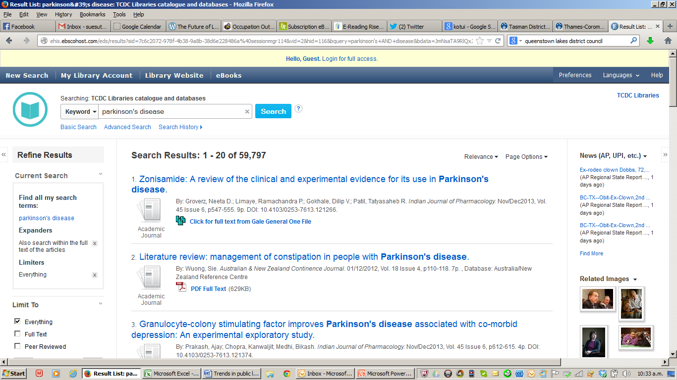
"The new computer system is excellent!! Really powerful searching tools. Great to have access to full text news articles, especially from overseas..."
Notes:
Not all content is freely available on the web and libraries make this available through subscribing to journals and reference materials. Provision of electronic subscription database content has been happening in public libraries through EPIC for the past 8-10 years. What is new is the ability to search seamlessly across all databases – this is the Thames Coromandel district libraries catalogue and a search for material on Parkinson’s disease. This has been made possible for Thames Coromandel as they have joined the Kotui consortium through the National Library of New Zealand. Libraries have been known for the quality and reliability of the content and collections they provide and it is important that this is true also in the digital medium.

Slide 12
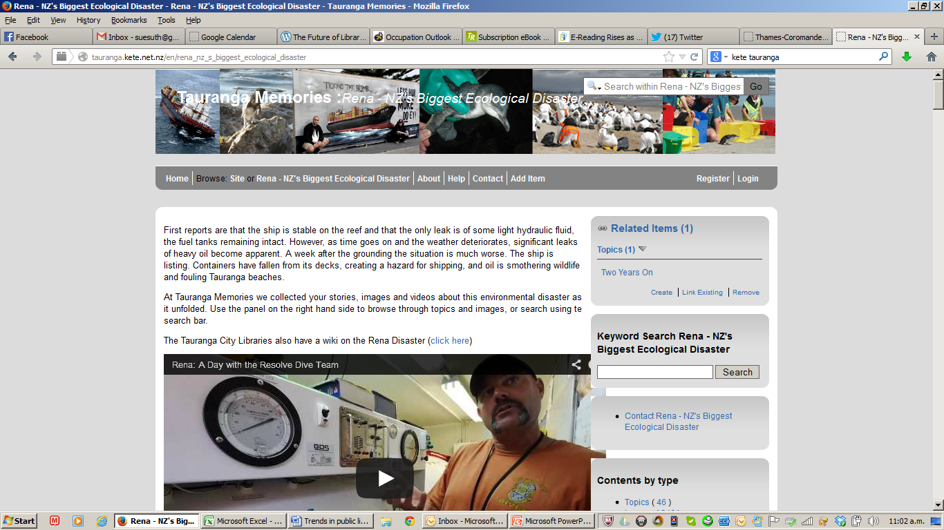
Notes:
Rising importance of local history and user created content whether that is through tagging and adding value to a library’s unique digital content resources; or through community created resources which are hosted on a library’s kete. Many libraries are working with local volunteers to capture the memories, images and documents that tell the local stories. This is just one example of capturing history as it happens - Tauranga library’s Kete resource on the Rena disaster

Slide 13
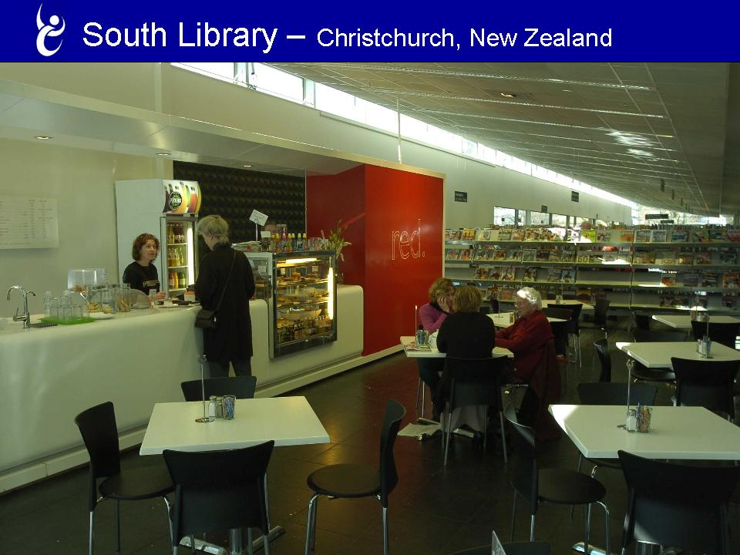
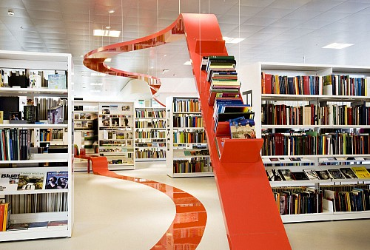
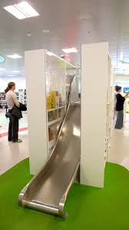
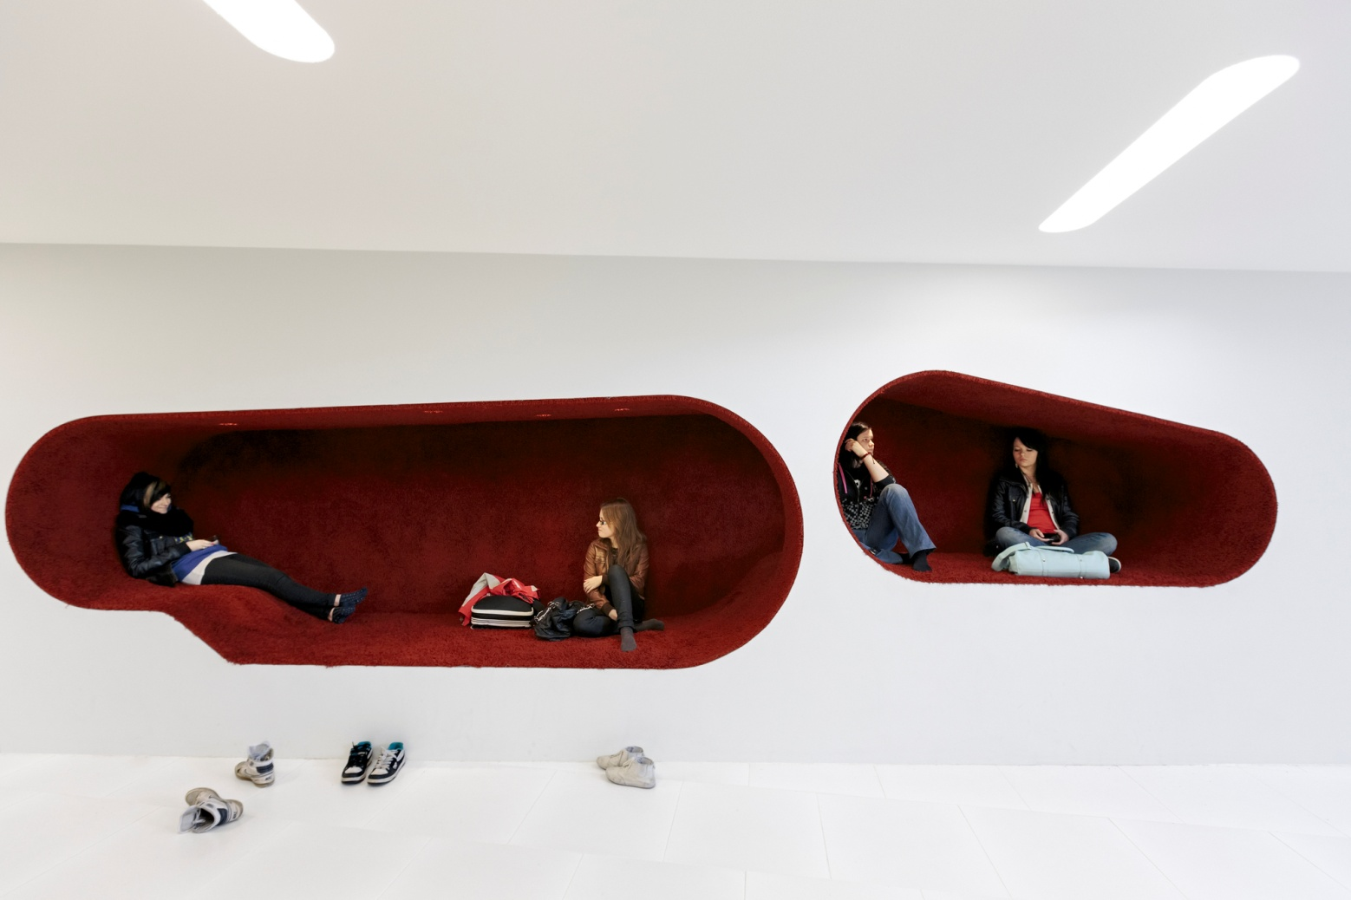
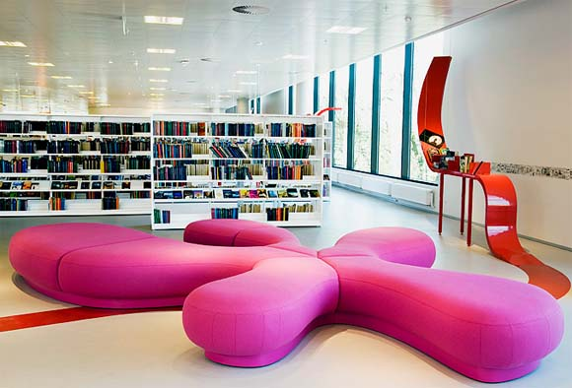
Cafe
Children’s slide
Hjørring Library Denmark
Seinojoki Library Finland
Notes:
How space is used in libraries is changing. More public space is given over to people activities and less to storage of books etc. Modern vibrant furnishings and comfortable seating; meeting spaces, cafes,

Slide 14
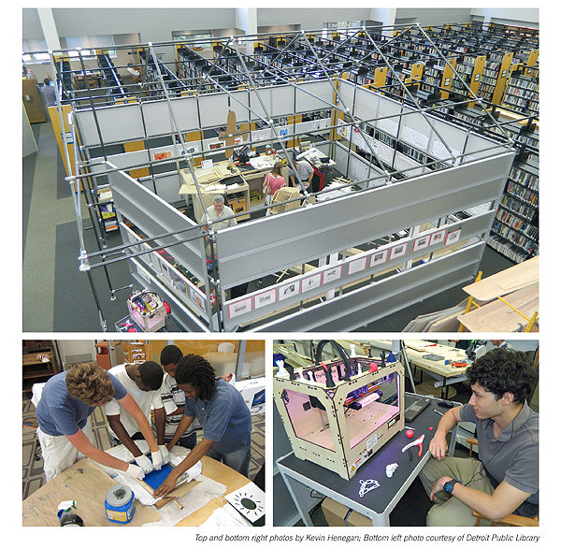
Maker
Space
Notes:
The creation of Maker spaces, Tech labs – one example is the Chattanooga Library , USA – has a public laboratory and educational facility with a focus on information, design, technology, and the applied arts. The 14,000 sq foot space hosts equipment, expertise, programs, events, and meetings that work within this scope. While traditional library spaces support the consumption of knowledge by offering access to media, this space is unique because it supports the production, connection, and sharing of knowledge by offering access to tools and instruction. This space is technology rich with such things as 3D printers, tablet PCs etc

Slide 15
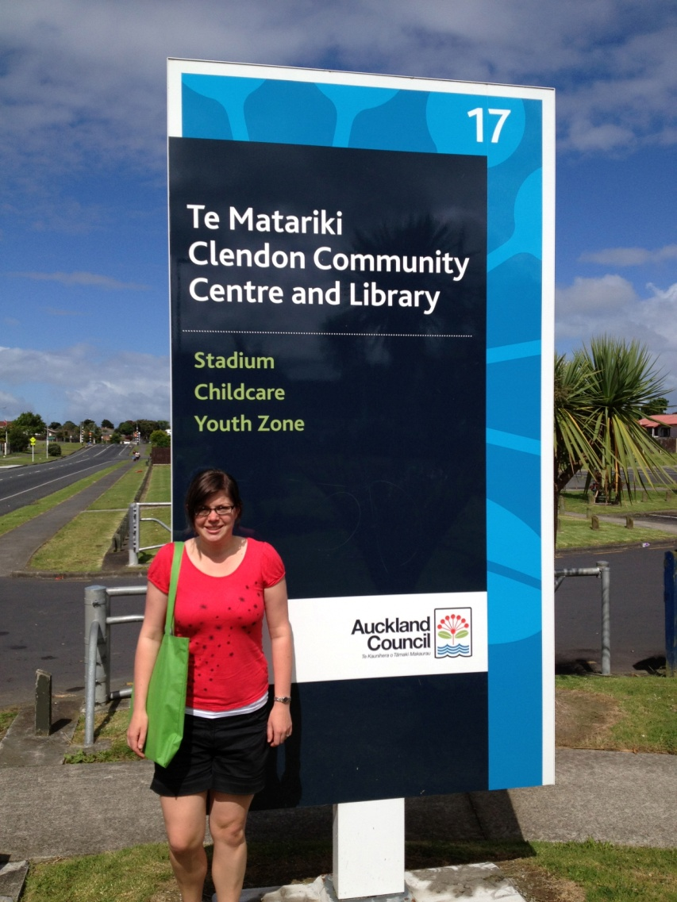
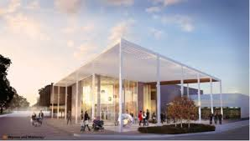
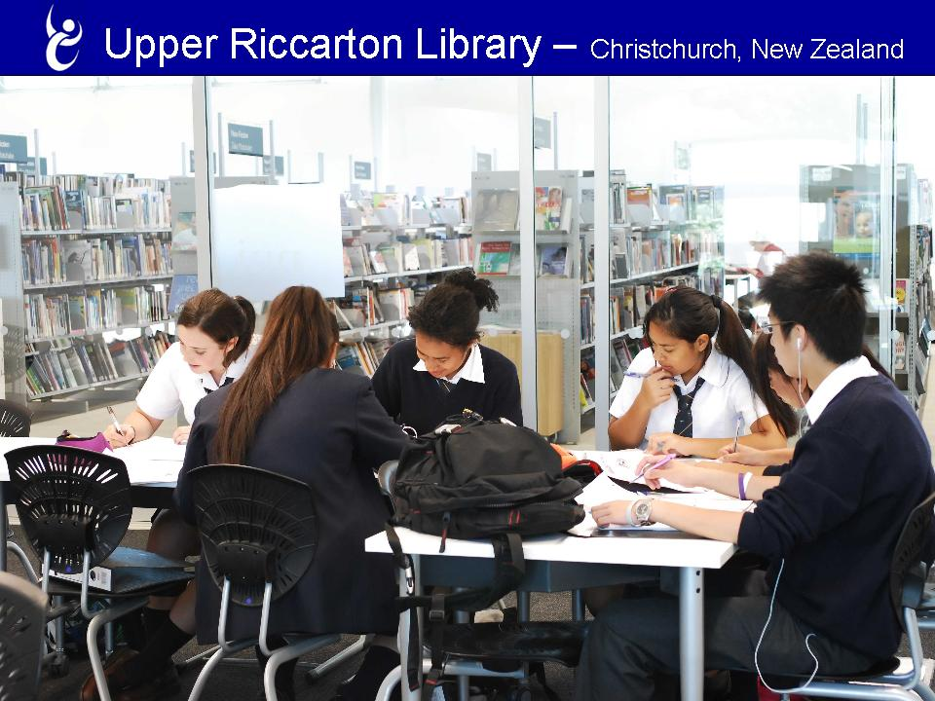
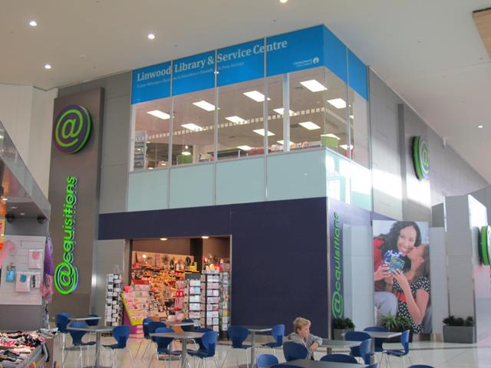
Library, Museum and Service Centre
School/community library
Eastgate Library in a mall
Notes:
In Denmark they have created the term “mash-up”library where libraries are combined with a range of different community, cultural, civic and commercial functions: libraries in malls, libraries with museums, libraries and council service centres, libraries and sports facilities.

Slide 16
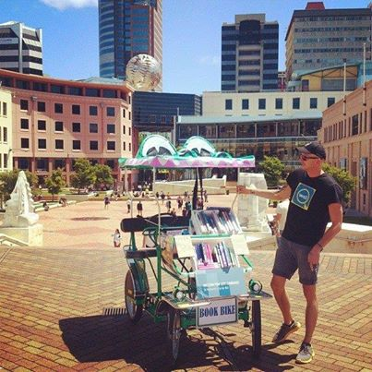
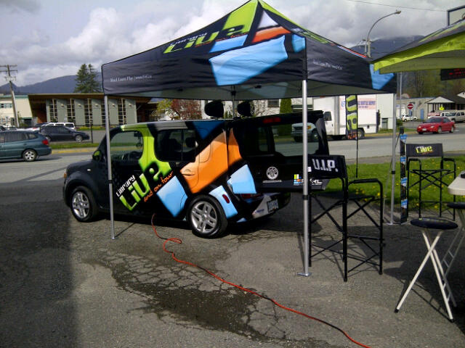
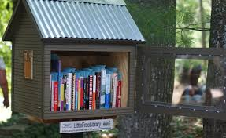

Finding innovative ways to take library to the community
Library bike, Wellington
Digi-van, Fraser Canada
Little Library – rural USA
Mobile library with wifi hot-spot, Christchurch
Notes:
And then there are some novel ways to take the library to the community: has this an application for the Queenstown water front??

Slide 17
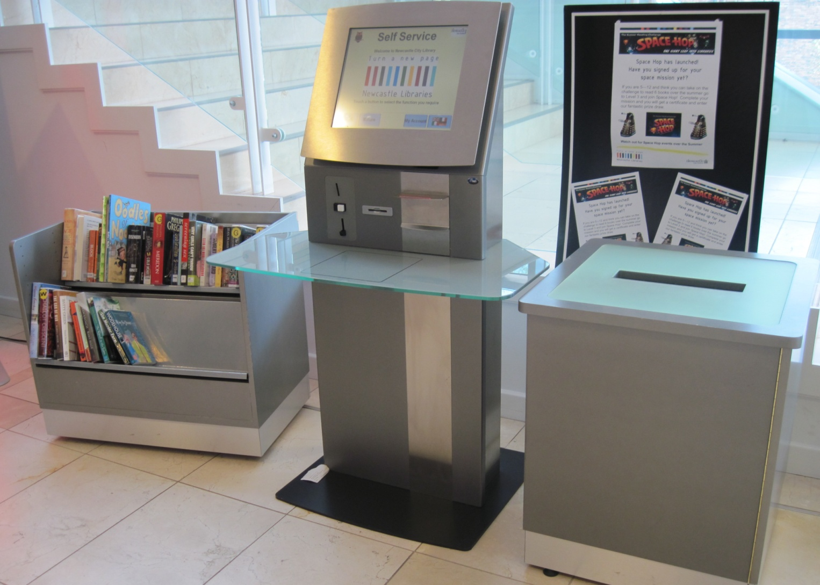
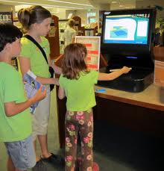
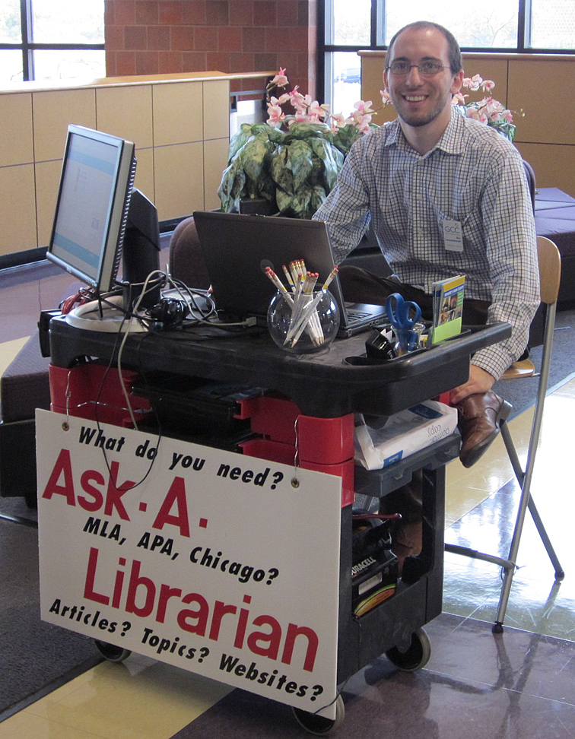
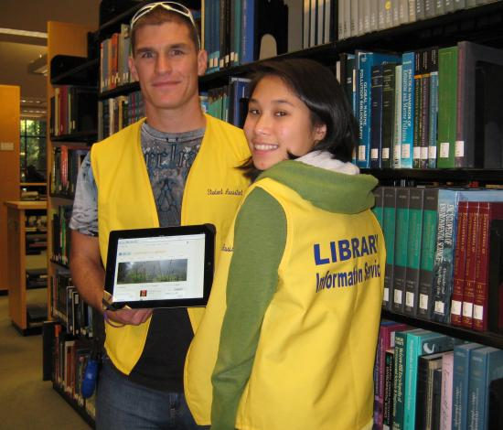
Notes:
Customer service is also changing. RFID technology enables more self help by customers and faster issue and return of stock, freeing up staff to do more advisory and programming work and better collection management. Staff are no longer behind desks but out on the floor ‘roving’ – often with tablet computer at hand so they can help customers wherever they are in the library, or stationed at small ‘pods’ rather than behind large counters.

Slide 18


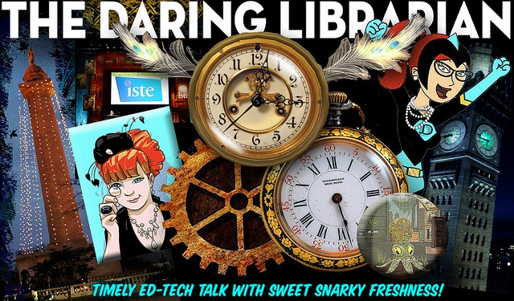
The Librarian of the future??
“The librarian isn't a clerk who happens to work in a library. A librarian is a data hound, a guide, a sherpa and a teacher. The librarian is the interface between reams of data and the untrained but motivated user.” Seth Godin
Notes:
Not only is the library changing but so are the people who work in libraries. Librarians are knowledge navigators, community connectors, metadata experts (the old cataloguing skills) and tech gurus. They need good people and digital skills and are expert problem solvers. Seth Godin, Author, entrepreneur and marketer maintains that the librarian is more vital than the library in today’s world.

Slide 19
Shaping up the future
Customers
Current State
Future trends
Future Services

Slide 20
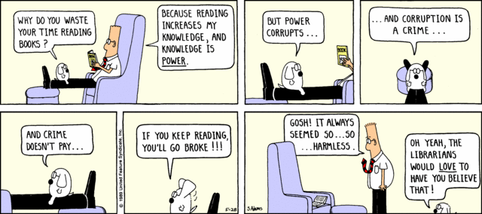
And finally….
Acknowledgement: Dilbert Cartoon

